Slide 1

Lecture 6:
Logical Effort

Slide 2
Outline
Logical Effort
Delay in a Logic Gate
Multistage Logic Networks
Choosing the Best Number of Stages
Example
Summary
6: Logical Effort

Slide 3

Introduction
Chip designers face a bewildering array of choices
  What is the best circuit topology for a function?
  How many stages of logic give least delay?
  How wide should the transistors be?
Logical effort is a method to make these decisions
  Uses a simple model of delay
  Allows back-of-the-envelope calculations
  Helps make rapid comparisons between alternatives
  Emphasizes remarkable symmetries
6: Logical Effort

Slide 4
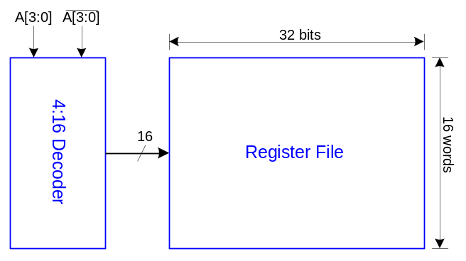
Example
Ben Bitdiddle is the memory designer for the Motoroil 68W86, an embedded automotive processor. Help Ben design the decoder for a register file.
Decoder specifications:
  16 word register file
  Each word is 32 bits wide
  Each bit presents load of 3 unit-sized transistors
  True and complementary address inputs A[3:0]
  Each input may drive 10 unit-sized transistors
Ben needs to decide:
  How many stages to use?
  How large should each gate be?
  How fast can decoder operate?
6: Logical Effort

Slide 5
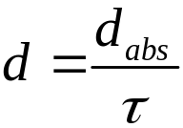
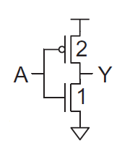
Delay in a Logic Gate
Express delays in process-independent unit
Delay has two components: d = f + p
f: effort delay = gh (a.k.a. stage effort)
  Again has two components
g: logical effort
  Measures relative ability of gate to deliver current
  g ≡ 1 for inverter
h: electrical effort = C_{out} / C_{in}
  Ratio of output to input capacitance
  Sometimes called fanout
p: parasitic delay
  Represents delay of gate driving no load
  Set by internal parasitic capacitance
τ =3RC
≈ 3 ps in 65 nm process
60 ps in 0.6 μm process
6: Logical Effort

Slide 6
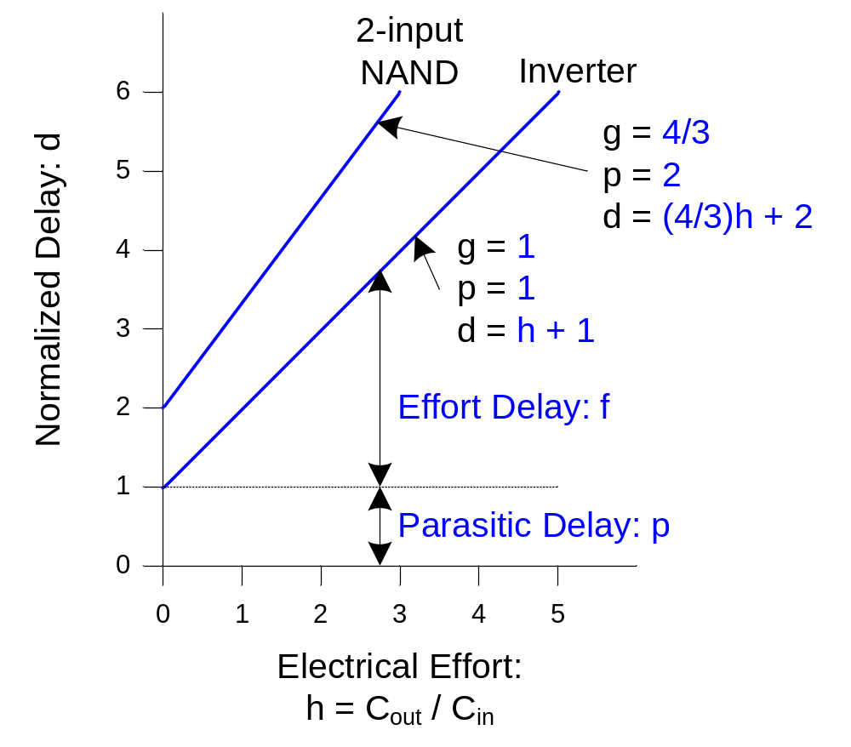
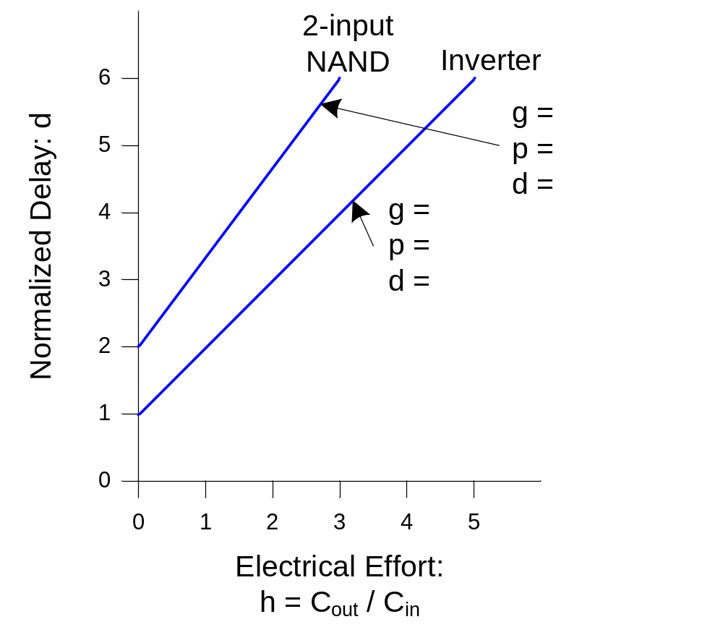
Delay Plots
d = f + p
  = gh + p
What about
NOR2?
6: Logical Effort

Slide 7
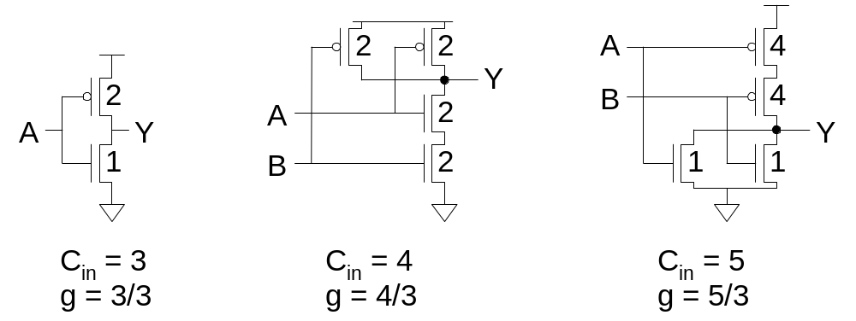
Computing Logical Effort
DEF: Logical effort is the ratio of the input capacitance of a gate to the input capacitance of an inverter delivering the same output current.
Measure from delay vs. fanout plots
Or estimate by counting transistor widths
6: Logical Effort

Slide 8
Catalog of Gates
Logical effort of common gates
Gate type | Number of inputs
 | 1 | 2 | 3 | 4 | n
Inverter | 1
NAND |  | 4/3 | 5/3 | 6/3 | (n+2)/3
NOR |  | 5/3 | 7/3 | 9/3 | (2n+1)/3
Tristate / mux | 2 | 2 | 2 | 2 | 2
XOR, XNOR |  | 4, 4 | 6, 12, 6 | 8, 16, 16, 8
6: Logical Effort

Slide 9
Catalog of Gates
Parasitic delay of common gates
  In multiples of p_{inv} (≈1)
Gate type | Number of inputs
 | 1 | 2 | 3 | 4 | n
Inverter | 1
NAND |  | 2 | 3 | 4 | n
NOR |  | 2 | 3 | 4 | n
Tristate / mux | 2 | 4 | 6 | 8 | 2n
XOR, XNOR |  | 4 | 6 | 8
6: Logical Effort

Slide 10
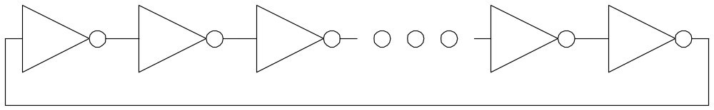
Example: Ring Oscillator
Estimate the frequency of an N-stage ring oscillator
Logical Effort: g = 1
Electrical Effort: h = 1
Parasitic Delay: p = 1
Stage Delay: d = 2
Frequency: f_{osc} = 1/(2*N*d) = 1/4N
31 stage ring oscillator in 0.6 μm process has frequency of ~ 200 MHz
6: Logical Effort

Slide 11
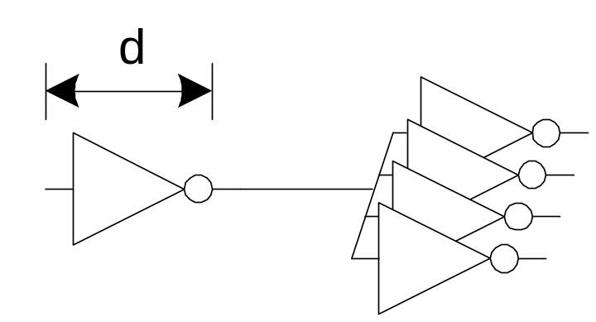
Example: FO4 Inverter
Estimate the delay of a fanout-of-4 (FO4) inverter
Logical Effort: g = 1
Electrical Effort: h = 4
Parasitic Delay: p = 1
Stage Delay: d = 5
The FO4 delay is about
300 ps in 0.6 μm process
15 ps in a 65 nm process
6: Logical Effort

Slide 12
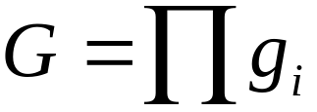
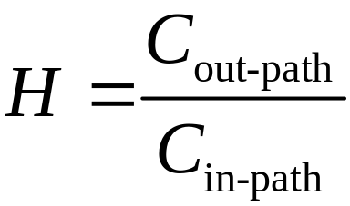
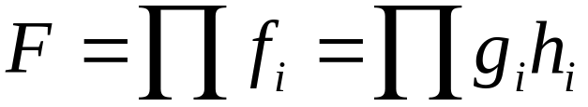
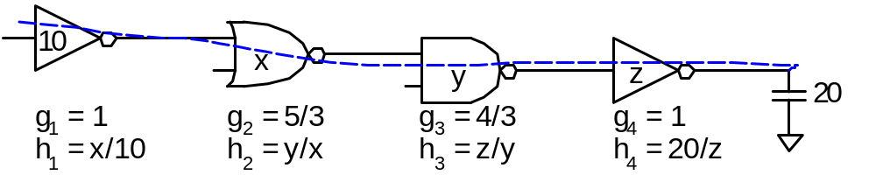
Multistage Logic Networks
Logical effort generalizes to multistage networks
Path Logical Effort
Path Electrical Effort
Path Effort
6: Logical Effort

Slide 13
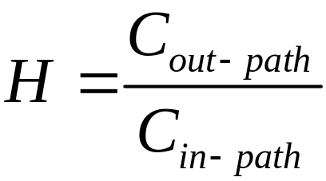
Multistage Logic Networks
Logical effort generalizes to multistage networks
Path Logical Effort
Path Electrical Effort
Path Effort
Can we write F = GH?
6: Logical Effort

Slide 14
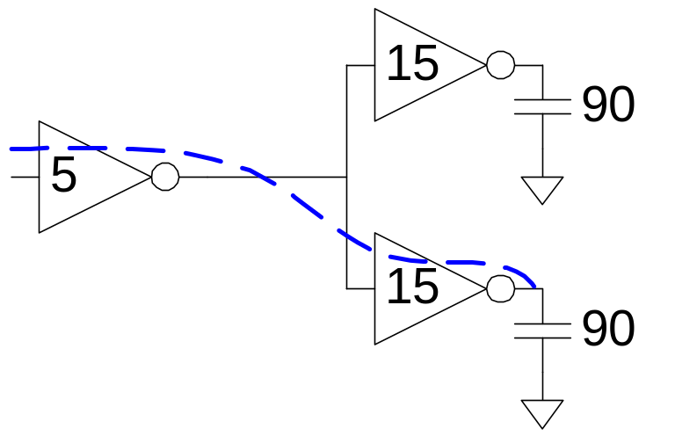
Paths that Branch
No! Consider paths that branch:
G = 1
H = 90 / 5 = 18
GH = 18
h₁ = (15 +15) / 5 = 6
h₂ = 90 / 15 = 6
F = g₁g₂h₁h₂ = 36 = 2GH
6: Logical Effort

Slide 15
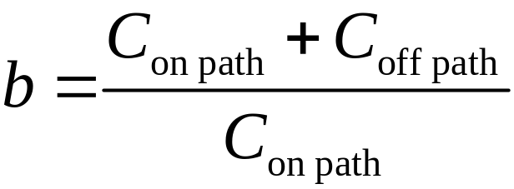
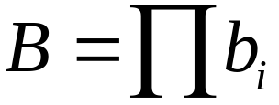

Branching Effort
Introduce branching effort
  Accounts for branching between stages in path
Now we compute the path effort
  F = GBH
Note:
6: Logical Effort

Slide 16
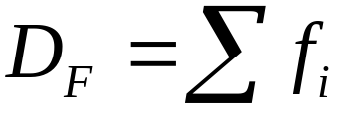
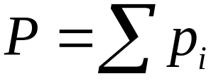
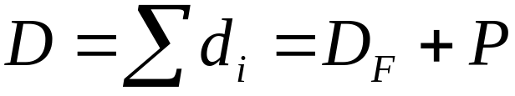
Multistage Delays
Path Effort Delay
Path Parasitic Delay
Path Delay
6: Logical Effort

Slide 17
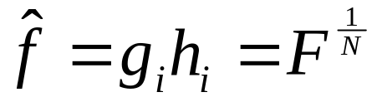

Designing Fast Circuits
Delay is smallest when each stage bears same effort
Thus minimum delay of N stage path is
This is a key result of logical effort
  Find fastest possible delay
  Doesn’t require calculating gate sizes
6: Logical Effort

Slide 18
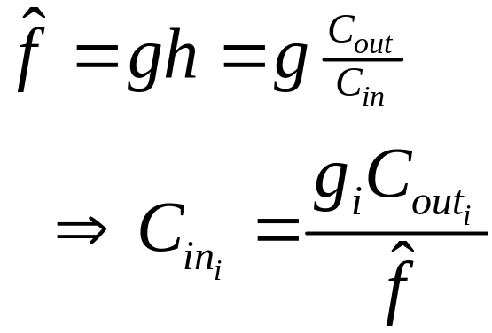
Gate Sizes
How wide should the gates be for least delay?
Working backward, apply capacitance transformation to find input capacitance of each gate given load it drives.
Check work by verifying input cap spec is met.
6: Logical Effort

Slide 19
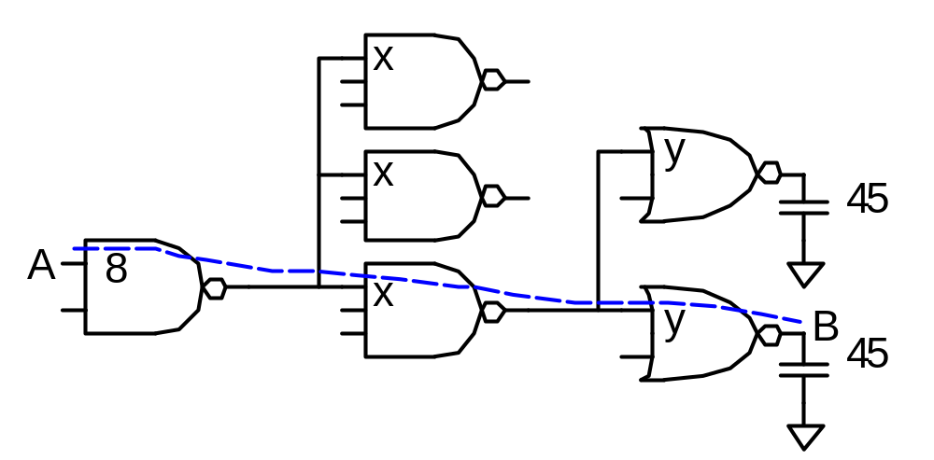
Example: 3-stage path
Select gate sizes x and y for least delay from A to B
6: Logical Effort

Slide 20
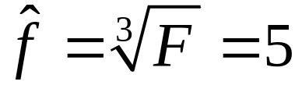
Example: 3-stage path
Logical Effort G = (4/3)*(5/3)*(5/3) = 100/27
Electrical Effort H = 45/8
Branching Effort B = 3 * 2 = 6
Path Effort F = GBH = 125
Best Stage Effort
Parasitic Delay P = 2 + 3 + 2 = 7
Delay D = 3*5 + 7 = 22 = 4.4 FO4
6: Logical Effort

Slide 21
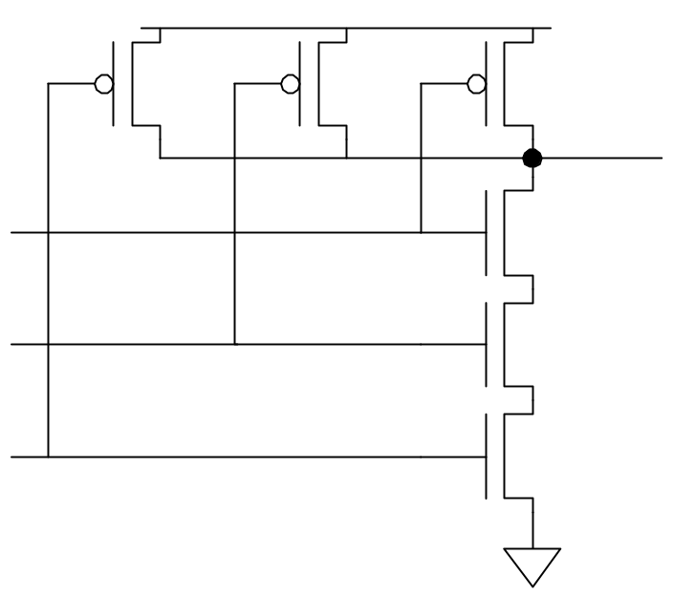
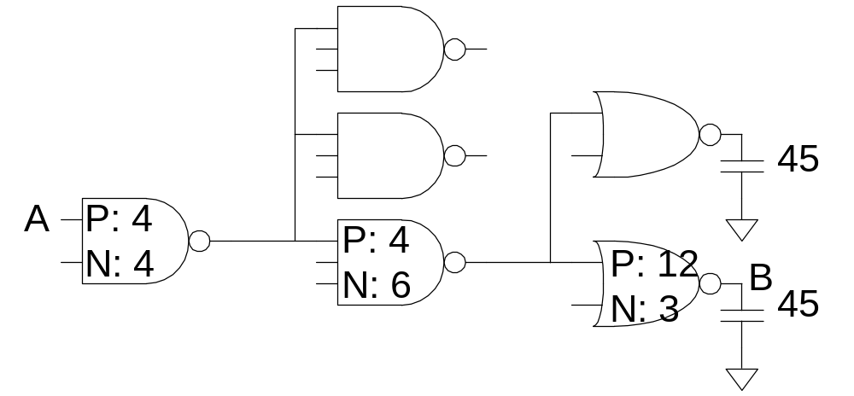
Example: 3-stage path
Work backward for sizes
y = 45 * (5/3) / 5 = 15
x = (15*2) * (5/3) / 5 = 10
2
2
2
3
3
3
6: Logical Effort

Slide 22
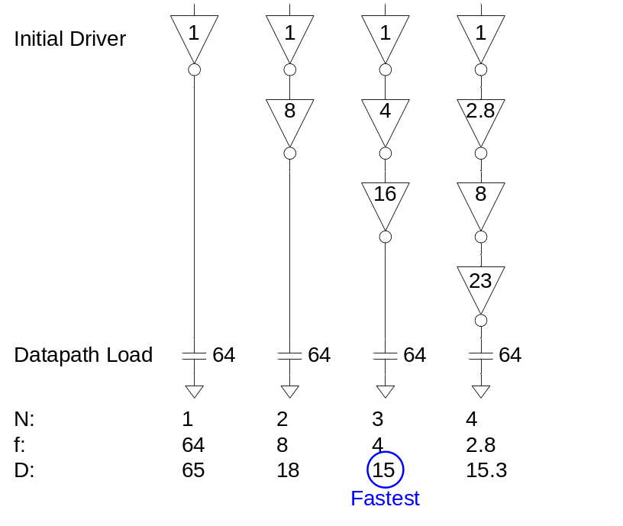
Best Number of Stages
How many stages should a path use?
  Minimizing number of stages is not always fastest
Example: drive 64-bit datapath with unit inverter
D = NF^{1/N} + P
= N(64)^{1/N} + N
6: Logical Effort

Slide 23
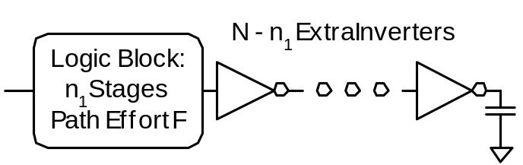
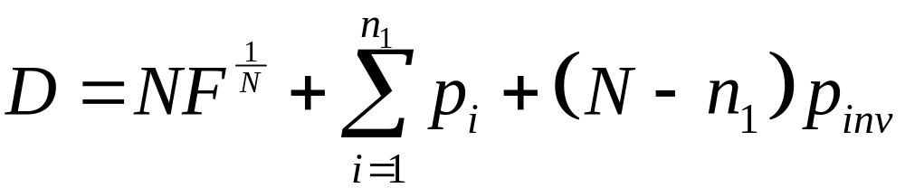
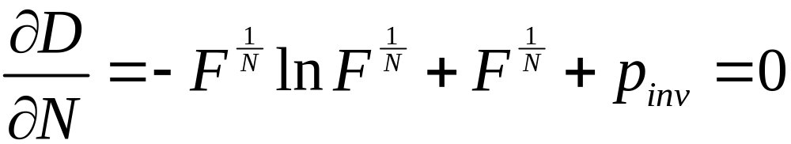
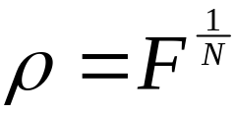
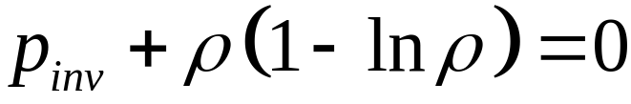
Derivation
Consider adding inverters to end of path
  How many give least delay?
Define best stage effort
6: Logical Effort

Slide 24
Best Stage Effort
has no closed-form solution
Neglecting parasitics (p_{inv} = 0), we find ρ = 2.718 (e)
For p_{inv} = 1, solve numerically for ρ = 3.59
6: Logical Effort

Slide 25
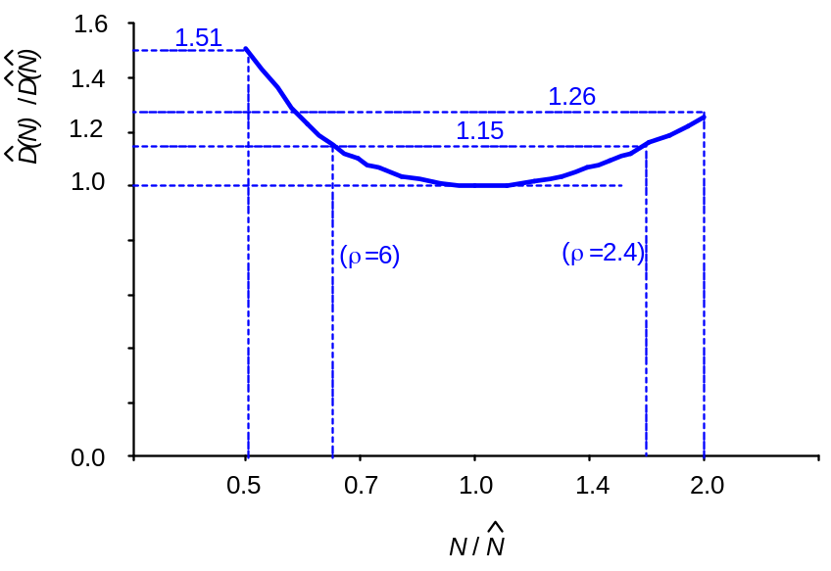
Sensitivity Analysis
How sensitive is delay to using exactly the best number of stages?
2.4 < ρ < 6 gives delay within 15% of optimal
  We can be sloppy!
  I like ρ = 4
6: Logical Effort

Slide 26
Example, Revisited
Ben Bitdiddle is the memory designer for the Motoroil 68W86, an embedded automotive processor. Help Ben design the decoder for a register file.
Decoder specifications:
  16 word register file
  Each word is 32 bits wide
  Each bit presents load of 3 unit-sized transistors
  True and complementary address inputs A[3:0]
  Each input may drive 10 unit-sized transistors
Ben needs to decide:
  How many stages to use?
  How large should each gate be?
  How fast can decoder operate?
6: Logical Effort

Slide 27
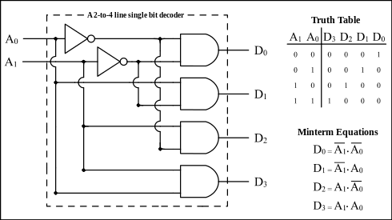
2-4 decoder
6: Logical Effort

Slide 28
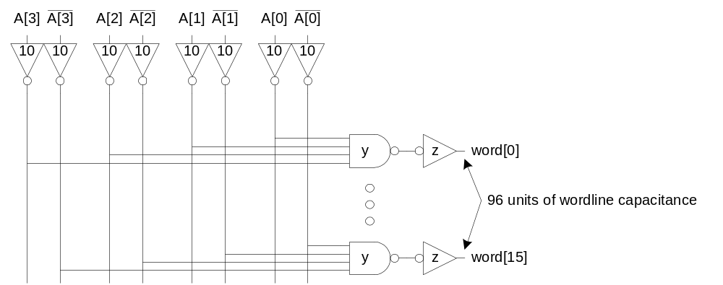
4-16 decoder
6: Logical Effort

Slide 29
Number of Stages
Decoder effort is mainly electrical and branching
Electrical Effort: H = (32*3) / 10 = 9.6
Branching Effort: B = 8
If we neglect logical effort (assume G = 1)
Path Effort: F = GBH = 76.8
Number of Stages: N = log₄F = 3.1
Try a 3-stage design
6: Logical Effort

Slide 30
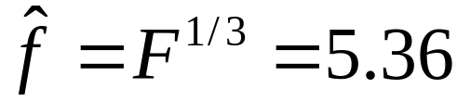
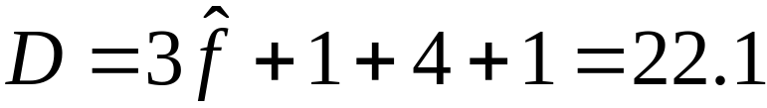
Gate Sizes & Delay
Logical Effort: G = 1 * 6/3 * 1 = 2
Path Effort: F = GBH = 154
Stage Effort:
Path Delay:
Gate sizes: z = 96*1/5.36 = 18 y = 18*2/5.36 = 6.7
6: Logical Effort

Slide 31
Comparison
Compare many alternatives with a spreadsheet
D = N(76.8 G)^{1/N} + P
Design | N | G | P | D
NOR4 | 1 | 3 | 4 | 234
NAND4-INV | 2 | 2 | 5 | 29.8
NAND2-NOR2 | 2 | 20/9 | 4 | 30.1
INV-NAND4-INV | 3 | 2 | 6 | 22.1
NAND4-INV-INV-INV | 4 | 2 | 7 | 21.1
NAND2-NOR2-INV-INV | 4 | 20/9 | 6 | 20.5
NAND2-INV-NAND2-INV | 4 | 16/9 | 6 | 19.7
INV-NAND2-INV-NAND2-INV | 5 | 16/9 | 7 | 20.4
NAND2-INV-NAND2-INV-INV-INV | 6 | 16/9 | 8 | 21.6
6: Logical Effort

Slide 32















Review of Definitions
Term | Stage | Path
number of stages
logical effort
electrical effort
branching effort
effort
effort delay
parasitic delay
delay
6: Logical Effort

Slide 33




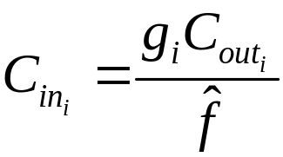
Method of Logical Effort
Compute path effort
Estimate best number of stages
Sketch path with N stages
Estimate least delay
Determine best stage effort
Find gate sizes
6: Logical Effort

Slide 34
Limits of Logical Effort
Chicken and egg problem
  Need path to compute G
  But don’t know number of stages without G
Simplistic delay model
  Neglects input rise time effects
Interconnect
  Iteration required in designs with wire
Maximum speed only
  Not minimum area/power for constrained delay
6: Logical Effort

Slide 35
Summary
Logical effort is useful for thinking of delay in circuits
  Numeric logical effort characterizes gates
  NANDs are faster than NORs in CMOS
  Paths are fastest when effort delays are ~4
  Path delay is weakly sensitive to stages, sizes
  But using fewer stages doesn’t mean faster paths
  Delay of path is about log₄F FO4 inverter delays
  Inverters and NAND2 best for driving large caps
Provides language for discussing fast circuits
  But requires practice to master
6: Logical Effort

